Slide 1

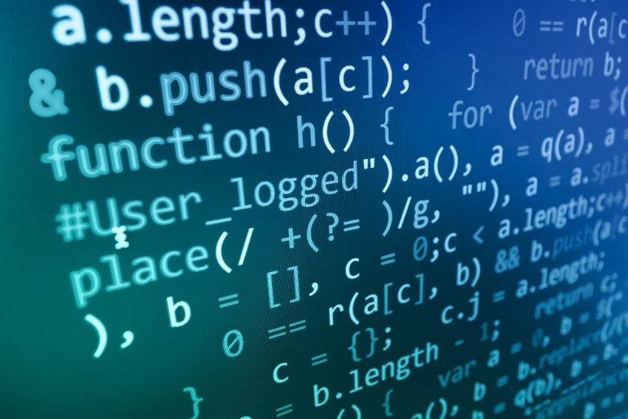

Basics of Algorithmization and Program
Prepared & Presented by: Mirlan Nurbekov, Lecturer
Office hours: Friday 9:00–17:00
AlaToo IT & Business College
Fall 2025

Slide 2



Course goals / Learning outcomes
01
Understand what algorithms are and why they are important.
02
Understand key properties of algorithms.
03
Translate problems into step-by-step solutions.
04
Implement basic algorithms using Python.
05
Analyze and compare simple algorithms.
06
Develop problem-solving skills through programming tasks.

Slide 3
Grading & Assessment
Midterm test: a comprehensive assessment of materials from week 1 till week 8 (100 points)
Final exam (100 points)

Slide 4
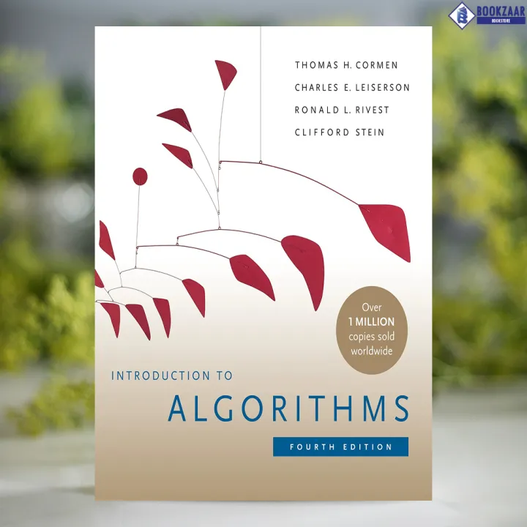
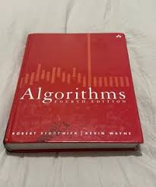
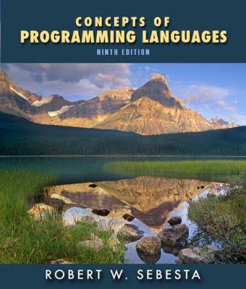
"Introduction to Algorithms" by Thomas H. Cormen
"Algorithms" by Robert Sedgewick and Kevin Wayne
"Concepts of Programming Languages" by Robert W. Sebesta

Slide 5
What is an Algorithm?
An algorithm, in the context of programming, is a finite sequence of well-defined, unambiguous instructions designed to solve a specific problem or perform a particular task. It provides a step-by-step procedure that transforms input data into a desired output.
Everyday examples:
Recipe for cooking
Directions to a location
Steps to log into an email account
Can you think of an algorithm you use every day?

Slide 6
A well-designed algorithm
1 - Definiteness (unambiguous): every step is precisely stated; no interpretation needed.
2 - Defined inputs & outputs: accepts clearly specified inputs and produces clearly specified outputs.
3 - Termination (finiteness): always halts after a finite number of steps with a stopping condition.
4 - Effectiveness (feasibility): each step is simple enough to be executed in finite time by a machine.
5 - Generality: solves the entire class of problems, not just a single example.

Slide 7
Why Algorithms Matter?
-> Core of Problem-Solving
-Provide a step-by-step way to tackle any complex task.
Example: Debugging code or planning study schedules.
-> Efficiency & Optimization
-Save time, memory, and resources.
Example: Google Maps finding the fastest route.
-> Scalability
-Work well even as input grows larger.
Example: Social media feeds showing posts from millions of users.

Slide 8
Why Algorithms Matter?
-> Universality
-Used across all areas of computing.
Example: AI making predictions, cybersecurity detecting threats, data science analyzing trends.
-> Real-World Impact
-Algorithms shape everyday tools.
Example: Search engines, online banking, shopping recommendations.

Slide 9
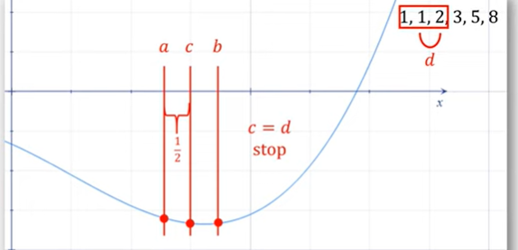
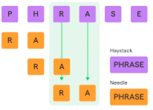

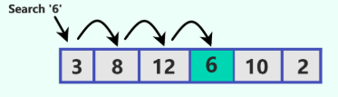
Types of algorithms you should know
Brute force
Sorting
Divide and conquer
Greedy
Dynamic programming
Backtracking
Recursive
Searching
Hashing
Graph

Slide 10
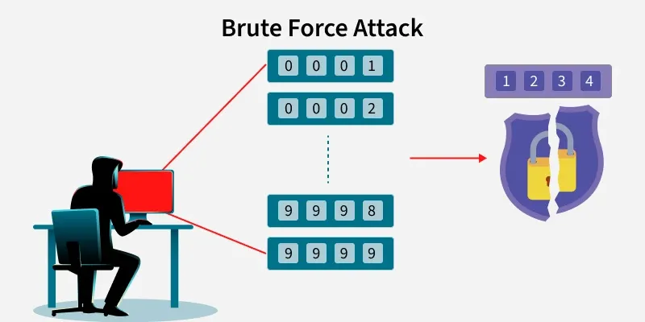
Brute force algorithm

Slide 11
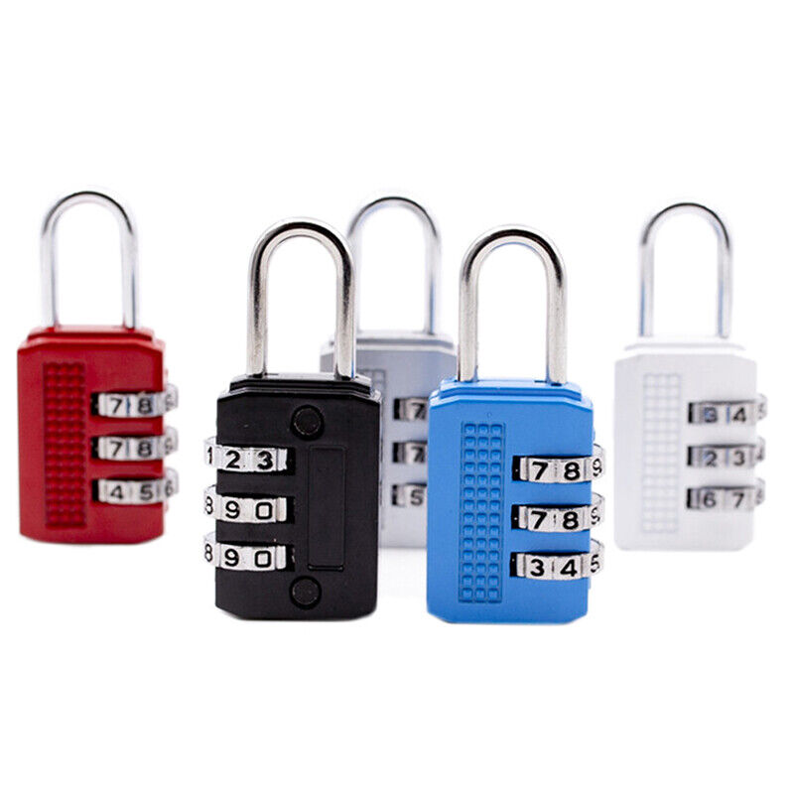
Brute force algorithm
Number of combinations -> 1000

Slide 12
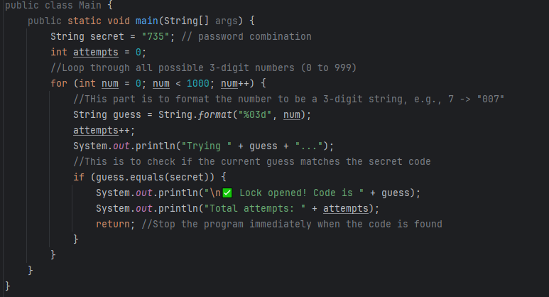

Slide 13
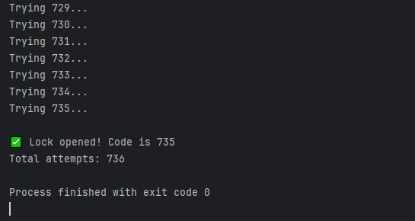

Slide 14
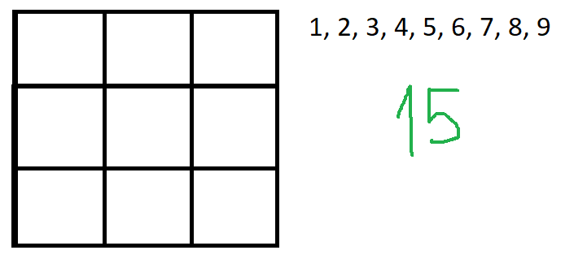
Look for a solution

Slide 15
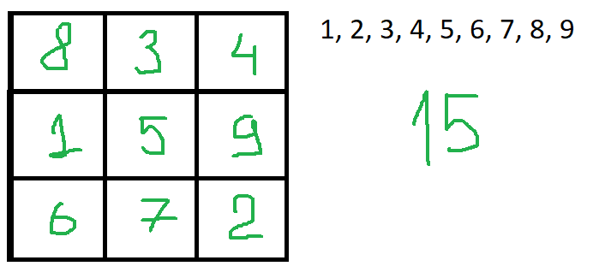
Result

Slide 16
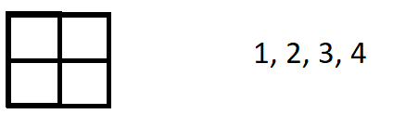

No solution question

Slide 17
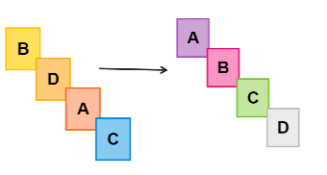

Types of algorithms you should know
1 - Sorting algorithms

Slide 18

Bubble sort

Slide 19
Bubble sort
Write a function called bubble_sort to sort a given list of numbers in ascending order using the bubble sort algorithm. Input: [64, 34, 25, 12, 22, 11, 90]
Output: Sorted array is: [11, 12, 22, 25, 34, 64, 90]

Slide 20
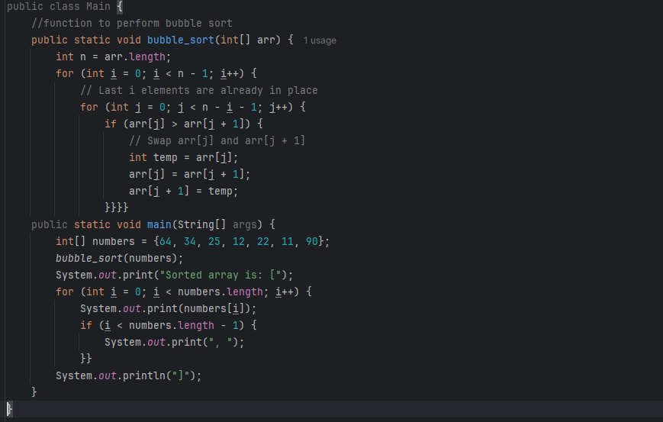

Slide 21
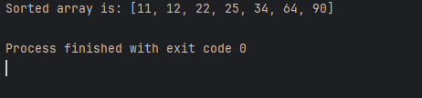

Slide 22
Improve a bit…
The basic version is inefficient. It keeps going through the list even after it's already sorted. Your task is to create an improved version that knows when to stop early, it makes the algorithm way faster for lists that are already sorted or almost sorted.

Slide 23
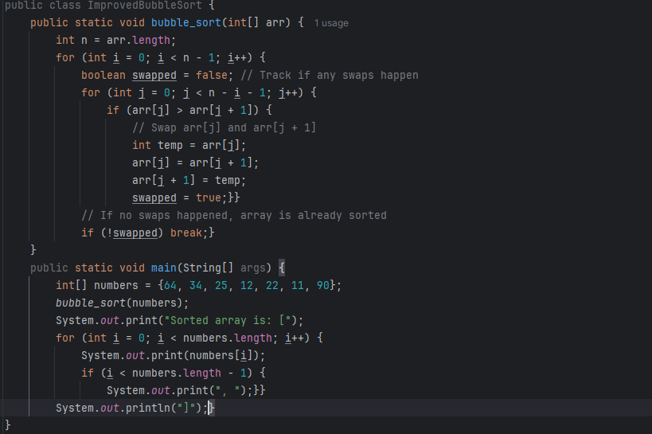

Slide 24
Comparison
[1, 2, 3, 4, 5, 6, 7, 8, 9, 10, 11, 12, 13, 14, 15, 16, 17, 18, 19, 21, 20]
Original Bubble Sort
Comparisons: 210
Swaps: 1
Optimized Bubble Sort
Comparisons: 39
Swaps: 1

